Slide 1
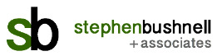
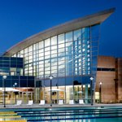

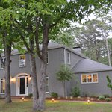
Risk Management and Insurance
Issues for Green Buildings

Slide 2
Continuing Education Credits
Course Title: | RISK MANAGEMENT AND INSURANCE ISSUES FOR GREEN BUILDINGS
Course Number: | 349751
Course Category: | Property and Casualty
Credit Hours: | 1.0 Sign in sheets in back of room

Slide 3
Continuing Education Credits
I will file your hours with the DOI after the completion of this session
You will be sent a Certificate of Attendance/Completion by email. Please retain for your records for five years
And … this presentation and a bibliography will be posted on my website for future reference.
See http://www.stephenbushnell.com

Slide 4
Your Instructor Today
Stephen Bushnell
40 + years P&C Insurance industry
2005 developed the first ever green building insurance coverages
2012 appointed to the USGBC Board of Directors in the Insurance Seat, elected twice – 2016 USGBC Advisory Council
2014 Launched Stephen Bushnell + Associates
Consulting practice focused on sustainability and risk management
2016 Named President of Sustainable Disaster Response Council

Slide 5
Course Objectives
Learn about and understand the following:
What is a green building
Green value proposition
Green risks
Green and insurance
State of the art green insurance coverages
How you can use this information

Slide 6
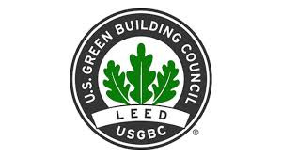

What is a Green Building?
A building that uses natural resources efficiently and is not detrimental to human health
Certification by a third party is critical
US Green Building Council’s LEED certification and US Department of Energy “Energy Star” are most credible

Slide 7
What is a Green Building?
LEED
New Construction, Renovations, Homes, Commercial Interiors, Neighborhoods
All commercial and institutional facility types
Property is scored against LEED Rating system and awarded points (Platinum, Gold, Silver and certified LEED ratings)
Energy Star
Commercial buildings in the upper quartile of energy efficiency
Appliances and building materials that meet performance standards

Slide 8
Green Building Data
Data from USGBC (2016) on LEED Certification
More than 82,000 total commercial projects
Over 15 billion total commercial square feet
More than 250,000 certified LEED for Homes residential units
1.85 million certified square feet per day, every day
More than 5 million people live and work in LEED buildings
Revenue in the green & sustainable building construction industry is expected to grow to approximately $287 billion by 2017
By 2018, green building in the US will account for over 3.3 million jobs

Slide 9
Green Building Value Proposition
Green Buildings are Energy Efficient (30% less on average USGBC data)
Water Efficient (50% less on average USGBC data)
Healthier for occupants (numerous studies)
Green Buildings command higher rents and occupancy rates, tenant churn is reduced (USGBC, McGraw Hill data)
Green features increase a building's value by an average of 7.5% and improve return on investment by 6.6% while decreasing operating costs by 8 to 9% (McGraw- Hill Smart Market Report)
  Third party certification (such as LEED) is critical

Slide 10
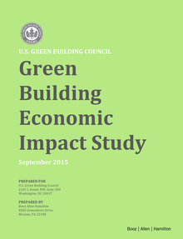
Green Building Economic Impact
Green Building Economic Impact Study: Booz Allen Hamilton
From 2015 to 2018 LEED certified buildings will generate:
$1.2 billion in energy savings
$715.3 million in maintenance savings
$149.5 million in water savings

Slide 11
Green Buildings and Human Health
Green building health benefits show up in several ways
Higher cognitive functions of green building occupants
Lower rates of illness and absenteeism
Higher rates of productivity
Higher cognitive functions of people living and working in the building????

Slide 12
Green Buildings and Human Health
Cognitive function scores were better in green building conditions compared to the conventional building conditions across nine functional domains, including crisis response, strategy, and focused activity level.
On average, cognitive scores were:
  61% higher in green building conditions
  101% percent higher in enhanced green building conditions
CO2, VOCs, and ventilation rate all had significant, independent impacts on cognitive function.
Harvard T.H. Chan School of Public Health

Slide 13
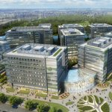
Green Buildings are Mainstream
Green buildings have become mainstream
2016: 40-48 percent of new nonresidential construction will be green, equating to a $120-145 billion opportunity
  Lower utility and maintenance costs
  More attractive to tenants
  Higher asset value and ROI
  Healthier for occupants
  Code and statute requirements
Marginally higher additional cost to build
(Booz Allen Hamilton 2%)
Negligible additional cost to renovate to green
Photo - USGBC

Slide 14

Green Buildings and Risk Management
Savvy insurance professionals understand aspects of a full risk management program, not just insurance
Green practices bring profound economic benefits and touch nearly every category of risk an organization faces
Overall, Green Buildings reduce physical risk
However they bring entirely new sets of risk that underwriters, agents and brokers must understand

Slide 15
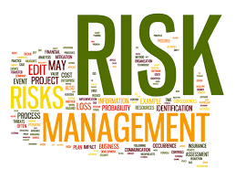
Green Buildings and Risk
Green Buildings present less risk than traditional buildings
Insurance Industry property cause of loss leaders:
Electrical fires
Plumbing Leaks
Envelope (roof, windows, doors, etc.) leaks

Slide 16
Green Building Commissioning
“Commissioning” a third party verification of construction and installation practices
Required for LEED Certification
Performed by an independent third party engineer
Confirms that key building systems (HVAC, electrical, plumbing, envelope components) have been installed properly
Means they are greener and safer
  Commissioning directly addresses leading causes of loss

Slide 17
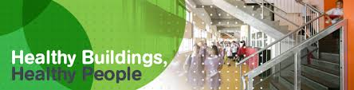
Green Buildings and Risk
Insurance industry “building age to loss ratio” studies
Buildings renovated with green features perform like a new building
Healthy Buildings
Growing body of evidence that green buildings reduce occupant and tenant health risks
  Does this mean that there is a new standard driving the duty of a building owner to provide a safe working environment?
Financial Risks
Regulatory Risks
Reputational Risks

Slide 18
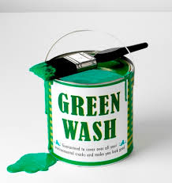
Green Buildings and Risk
Risks of not building green or pursuing certification
Foregoing third party verified certification
Disclosure of energy performance
Energy and water price volatility
Cap and Trade or Carbon Tax impacts on energy price
Greenwashing
Obsolescence

Slide 19
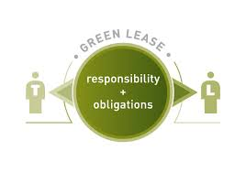
Green Buildings and Tennant Risk
Tenant Risks
Risk of the “Split Incentive” when the building owner pays for the green features but the tenant benefits from the reduced utility costs
Getting the lease right
  Mitigation: Several Green Lease Toolkits have been developed (BOMA and California Sustainability Alliance)
Tenants degrading green aspects with “brown” behavior
  Mitigation: Tenant relations and education, Integrated design, leases, out of the box thinking (provide free green cleaning supplies)

Slide 20
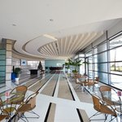
Green Buildings and Performance Risk
Performance Risks
Building does not achieve green goals
Architects dilemma
  Warrantees and RFPs
Contractors too
Operations
  Most underperformance due to improper operation of sophisticated building systems. Mitigation: Integrated Design Process – all parties (architect, contractor, subs, building owner and building operations personnel involved in “charrette” meeting throughout construction/renovation
“Leedigation”
Photo - USGBC

Slide 21
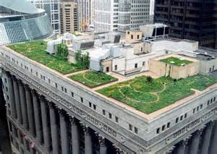
Green Buildings and Physical Risk
Physical Risks
Vegetated roof
  Weight of roof, especially when saturated with rain or covered in snow
  Leakage when roots pierce membranes and root barriers
  Combustibility of dry or dead vegetation
  Falling objects (including people)
Photo – City of Chicago

Slide 22

Green Buildings and Physical Risk
Physical Risks
New and untested building materials and technology
  Stay with the “tried and true”
Recycling and waste reduction
  Separation and segregation of waste and recycling

Slide 23
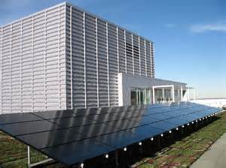
Green Buildings and Construction Risk
Physical Risks
Solar Panels
  Wind and hail
  Theft
  Fire department issues
Worcester Polytechnic Institute (WPI) Green Building Risk Study
Battery back up storage
  Separation and physical protection
Photo - EPA

Slide 24
Green Buildings and Insurance
Green Building Insurance Products
A look at the “state of the art” coverages
No standard “green” form, each insurer’s is unique
Standard property insurance policies may not adequately cover green buildings
CERES publishes reports outlining insurer’s Green Coverages

Slide 25
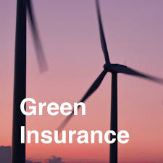
Green Buildings and Insurance
Green coverage can be categorized into three major components:
Certified Green Building Coverage
  For buildings that are already certified
Green Upgrade Coverage
  Pays to make a building (or it’s contents) greener after a covered loss
Green Extensions of coverage
  Can apply to certified or upgrade coverages

Slide 26
Green Buildings and Insurance
Certified Green Building Coverage
Expands coverage to cover Green gaps in standard policy;
  Trees and plants part of vegetated roofs
  Remote property (more than 100 or even 1000 feet way from the described building
  Underground property that is part of an alternative energy, heating/cooling or water system
  Loss of income for alternative energy systems
Some very broad property forms already include these features, most need to be modified to add coverage
Some insurers offer a discount for certified buildings

Slide 27
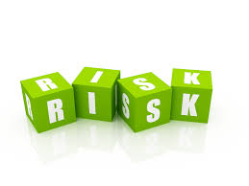
Green Buildings and Insurance
Green Upgrade Coverage
Pays to rebuild or repair real and personal property damaged or destroyed by a covered loss with green alternatives
Upgrade can include electrical system, building envelop, HVAC, plumbing, interior finish (carpeting, paint, etc.), electronics, furniture and fixtures, and more
The Upgrade will not cover equipment which was not present before the loss
Upgrade modifies the “like kind and quality” replacement cost provision

Slide 28
Green Buildings and Insurance
Green Upgrade Coverage
Since nearly every insurer has a unique proprietary form it is important to review the coverage form to understand:
Definition of “green” - It could range from “property that is acceptable to LEED” all the way to “property that uses energy and water more efficiently and is not detrimental to human health”
Limit available for the upgrade. It can be as low as low as $5000 or as high as the policy limit
Some forms will cover the additional cost of rebuilding a total loss as a LEED certified building (usually has a sublimit)
Pricing for upgrade varies by insurer

Slide 29
Green Buildings and Insurance
Green Extensions of Coverage
These can apply to both Certified and Upgrade coverages. Extensions include:
Debris recycling. Rather than bring debris to a landfill, they are recycled whenever possible
Post reconstruction indoor air quality testing or a fresh air flush out
Post reconstruction commissioning by a third party engineer to make certain repairs are both green and safe

Slide 30
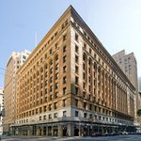
Green Buildings and Insurance
Green Extensions of Coverage
LEED professional design expense
LEED certification fees (this applies to both certified buildings and upgrade if the upgrade results in the building being LEED eligible)
LEED upgrade. Applies to certified buildings - Post loss upgrade to the next highest level of LEED certification
Photo -USGBC

Slide 31
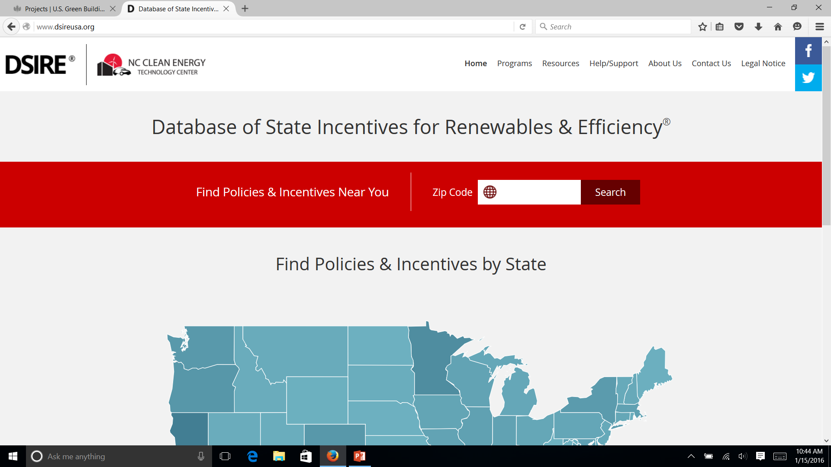
Green Buildings and Insurance
Green Extensions of Coverage
Financial incentive coverage
  Tax
  Rebates and grants
  Utility
Builders Risk soft cost extension to pay for additional time (and related costs) to secure green materials or qualified subcontractors
Business Income for green features (including alternative energy systems)

Slide 32
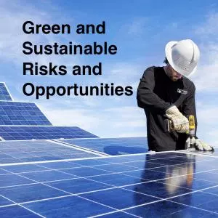
Green Risk Management
Green Risk Management
Green in a risk management context - the insurance industry can provide risk services beyond a coverage grant
Any degree of greening a building or its contents can reduce risk.
Many insurers and brokers also offer green risk consulting in conjunction with their green coverage
  They advise insureds on low cost ways to green their property and operations and reduce their risk as part of their overall risk services program

Slide 33
Green Buildings and Risk Summary
Green buildings and practices reduce risk
Green Buildings present new and challenging risks which can be managed with traditional risk management techniques
Commissioning and green renovation of ageing buildings significantly reduce physical risks
Financial and reputational risks and benefits require an enterprise risk management mindset
Sustainable Risk Management is a developing theory to support risk practitioners with green buildings and sustainable business practices

Slide 34
Green Buildings and Total Cost of Risk
Green and the Total Cost of Risk
IRMI definition:
“The cost of managing risks and incurring losses
Total cost of risk is the sum of all aspects of an organization's operations that relate to risk, including retained (uninsured) losses and related loss adjustment expenses, risk control costs, transfer costs, and administrative costs”

Slide 35
Green Buildings and Total Cost of Risk
How do green buildings impact total cost of risk?
Reduced losses (retained and transferred)
Reduction in electrical fires and plumbing/envelop leaks
Mitigate occupant health risks (sick building and more)
Mitigate financial and regulatory risks
Cost to build or renovate green renovate is a risk management cost – green renovations reduce risk – commissioning reduces risk - improvement in occupant productivity

Slide 36
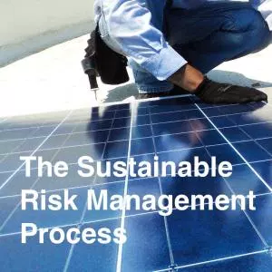
Green Opportunities
How can you use this information?
Understand the connection between green building principles and risk
Understand the role insurance plays in the risk management process
Think about how this information could change the way we compete

Slide 37
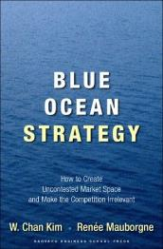
Green in the blue ocean
Blue Ocean Strategy - How to create uncontested market space and make competition irrelevant
Strategy address expanding the boundaries of how we compete in the “red ocean” to find uncontested “blue ocean” space

Slide 38
How to use this information
Think about these four concepts
How much to you pay per year for homeowners insurance and electricity (electricity is probably 300% more)
How often must you cut premiums or reduce your commission to retain an account, despite the strong differentiators you have included? Are you frustrated that insurance is too often a price driven commodity play?
Green building practices reduce both risk and the insureds expenses. Impacts (reduces) TCOR
What if you offer broad green building coverage, insightful green risk management and risk control services that address low and no cost green techniques? Is this how you can create a Blue Ocean expanded boundary?

Slide 39
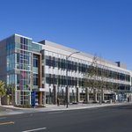
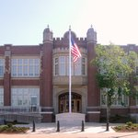
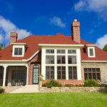
Summary
Green is now Mainstream
Economic and health value proposition
Green presents less risk (overall)
New green risks
Green insurance
Green and the “Total Cost of Loss”
Green opportunities

Slide 40
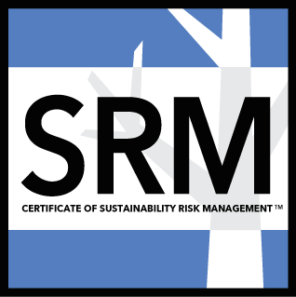
Green Buildings and Construction Risk
Opportunity to learn more
The On Line Sustainable Risk Management Certificate Program. This is a four hour, on demand webinar series presented by Stephen Bushnell + Associates and Green Buildings Online
Check out the website:
https://www.greenrisk.org

Slide 41
Thank You
Thank You
Steve Bushnell
Stephen Bushnell + Associates
Contact me:
Stephen.bushnell@stephenbushnell.com
1-415-432-4455 (o)
2-707-980-2050 (c)
Presentation and bibliography available at http://www.stephenbushnell.com (blog tab)

Slide 46
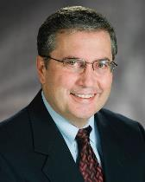
Contact
Stephen G. Bushnell
Principal
Stephen Bushnell + Associates
201 Mission Street, Suite 1200
San Francisco, CA 94105
Phone: +1 415 432 4455
Fax: +1 415 432 4301
E-Mail: stephen.bushnell@stephenbushell.com

