Slide 1
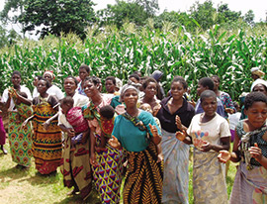
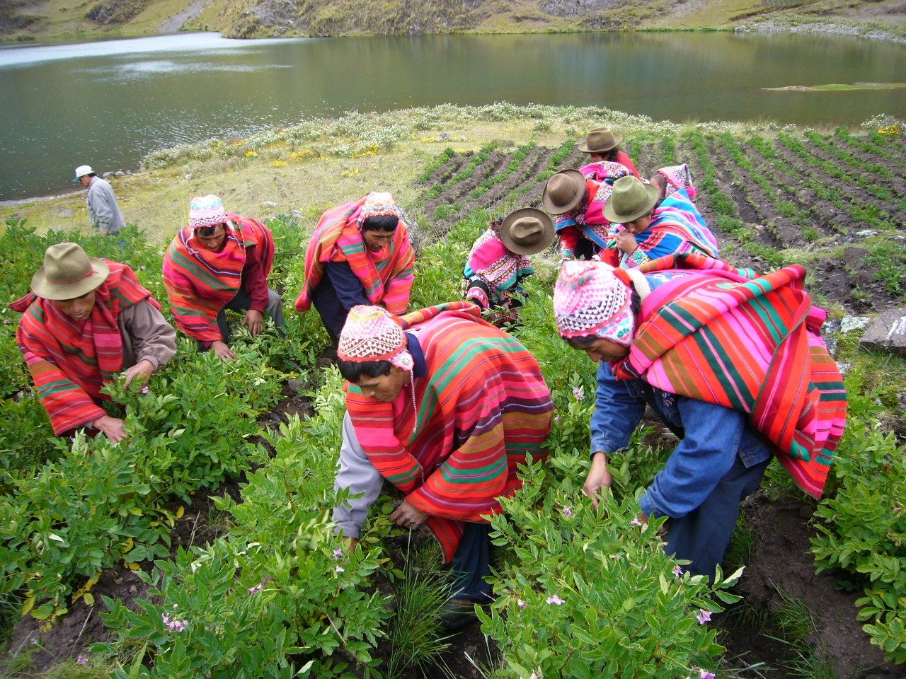
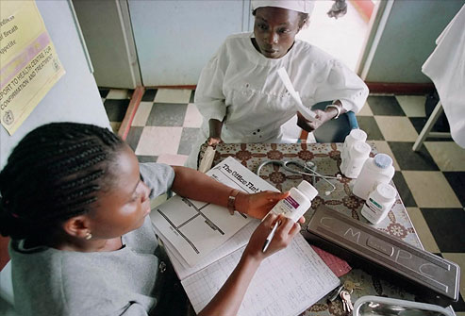
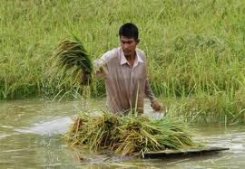
Kim B. Staking, Assistant Professor
California State University, Sacramento
Finance, Risk Management & Insurance
MicroInsurance
Origins – Challenges – Lessons
CPCU Society
Golden Gate Chapter
June 10, 2016

Slide 2
MicroInsurance Origins
MicroFinance Setting
Failings | Solutions | Examples
Section 1:

Slide 3
Those at the Base of the Pyramid are only too aware of risk
How are risks managed in informal markets?
Steps in Risk Management:
  Risk Measurement – awareness and precision
  Risk Controls – reduce frequency and/or severity of risk events
  Risk Transfer – pooling, hedging and exteral transfer
  Geographic vs. intertemporal risk management

Slide 4
Informal risk management
Family
Community and community organizations
Elaborate social networks
Savings
Underinvestment
  Don’t subject scarce capital to risk of loss
Government support – basis risk
International support – start-up costs; basis risk

Slide 5
Insurance Premium: π = E(L) + λ
Fair Premium = expected loss plus loading
  E(L) should be calculated in present value terms (account for investmetn income!)
Loading includes:
  Capital cost [protection against loss above E(L)]
  Distribution marketing
  Loss Administration expenses
  General overhead
  Profits

Slide 6
Models for Microinsruance
Private Insurance:
Profit Motivation
Community Based Insurance:
Member Needs Motivation
Often teamed with profit oriented microfinance
Initially linked to loans
Professional management
Actuarial models incipient
Risk Classification
Separate capital
Often teamed with community based microfinance
Fill perceived needs in community
Limited actuarial capacity – losses shared within the community
Pricing somewhat informal at first – need to sharpen pencils
Capital mixed with other projects

Slide 7
MicroInsurance
Section 2
Examples
Uganda, Peru, South Africa, Malawi, Vietnam

Slide 8
Finca Uganda / AIG
Life Insurance for the Poor in Uganda
UGANDA: Population 34.8 MM | GDP per Capita $529.2
  24% below poverty line
  43% non-poor but insecure
  33% classified as middle class
In 1996/97 FINCA Uganda developed a microinsurance proposal and presented it to AIG.
By 2005, the plan insured 1.6 million lives through 24 MFIs in Uganda and one each in Tanzania and Malawi.
AIG grossed $800,000 on the plan in 2004, 20% of that profit.

Slide 9
AllLife South Africa
Life insurance for people with AIDS
AllLife in South Africa was established to insure only H.I.V.-positive people
AllLife is not a charity, but a successful insurance company – just one with an odd business model
South Africans can get antiretroviral treatment for free
AllLife requires its insured have regular medical visits, get periodic tests and follow treatment protocols

Slide 10
AllLife South Africa
Life insurance for people with AIDS
AllLife has agreements with most medical providers, and can pull data about its clients. Computers track clients' medical progress and provide reminders to get blood tests or visit the doctor. Staff members call each client once a month, and are available by phone all day, every day.

Slide 11
Weather Risk Peru
Agriculture and El Niño
Peruvian Farmers face the risk of El Niño. Erratic weather patterns that arise about every 10-12 years
Extreme el Niño events arise every 3-4 cycles

Slide 12
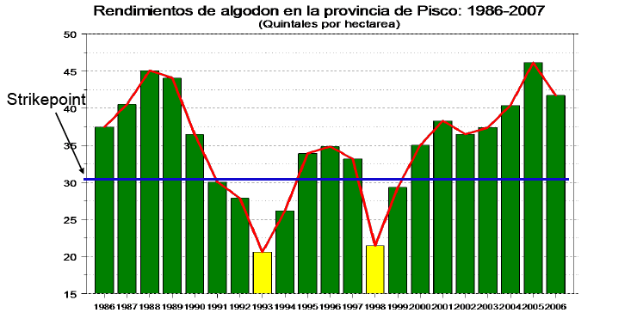
Peru El Niño Risk
Is Insurance Possible?
Yields on Cotton en the Province of Pisco, Peru 1986-2007
(Quintales por hectare ≅ 41 pounds per acre)
UC Davis Study

Slide 13
Weather Risk Malawi
Groundnuts & Maize
Drought can completely decimate a crop (average 1 of every 10 years)
Improved seed can significantly increase production (more than double)
Improved seed is not as drought tolerant as traditional seeds
No Brainer:
Pure Risk Premium = 10% crop value
Value of crop doubles
Over 10 years 90% higher income
BUT – Assumes ability to survive drought

Slide 14
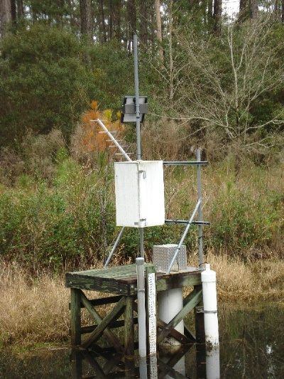
Malawi
Weather Stations
Weather Risk Management
Farmers traditionally used drought resistant seeds to manage risk
Simple weather stations have allowed for parametric insurance
Improved seeds sold with drought insurance certificate have increased yields by more than 100%

Slide 15
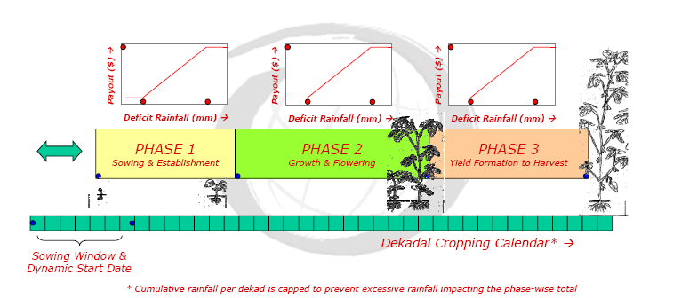
MicroInsurance Process – Malawi
Source: World Bank

Slide 16
Malawi farmers noted the following results in just two growing seasons
Yield, Land, Farm Activities
100% increased crop yield; increased amount of land in production and diversified crops
66% bought oxen, ox carts or both
33% built new barns or other farm buildings from increased earnings
33% were planning to introduce irrigation in order to increase the growing season
Other Socio-Economic
33% were able to build new brick houses
50% increased the amount of schooling for their children
50% opened savings accounts
100% received financial and technical education
100% expressed confidence in their financial future education

Slide 17
MicroInsurance Malawi
Impact Statement
The last word comes from Harry Kafakalunda, one of the smallholder farmers.
The benefits for me are a better living
standard, better food. I have been able to
build a better house. And I have bought
an ox cart from last year’s earnings.
This would not have been possible before.

Slide 18
Vietnam Agricultural Catastrophes
Community Based MicroInsurance
In Vietnam there are extreme weather events (drought and more common flooding) as well as pestilence that can attack an entire community.
Public insurance program (Law 315) provides 100% subsidy for extreme poor; 80% for very poor; and 20% for poor. Only the extreme and very poor tend to participate. Funds for subsidy are lacking
Pilot Program
Nghệ An Province, Vietnam
Micro.Insurance.Academy

Slide 19
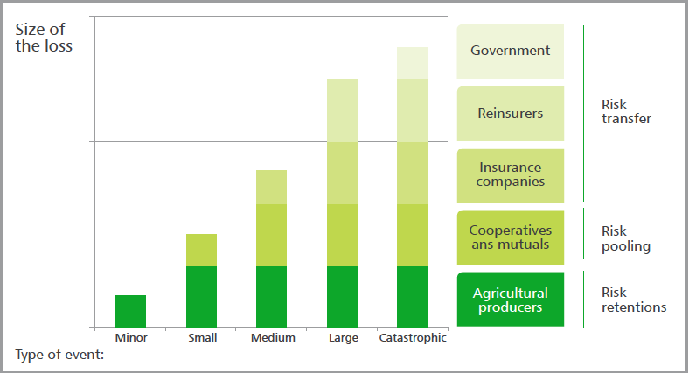
Vietnam Agricultural Risk Layering
Efficient Risk Allocation
Source: World Bank

Slide 20
Reducing Premium Cost
Impact of Policy Structure
Risk Transfer Decision
Policy Structure
 | Severity
Frequency |  | Low | High
 | Low | Ignore | Transfer
 | High | Manage | Avoid
Use deductible to avoid loading costs on small losses that are easily absorbed
  Higher deductible and maximum coverage result in lower premium
  Some risks can easily be shared within community

Slide 21
Community Partnership with MicroInsurer
Community representatives supervise and advise individuals on risk management alternatives
The Community is a trustworthy partner and interlocutor to both insurer and insured (avoids bad risks)
The Community can become the “insured party”
  Channels information and educate community members
  Collects premium on behalf of the MicroInsurer
  Verifies losses and communicates with the MicroInsurer
  Distributes loss payments received from the MicroInsurer according to experience
Notes:
These can all be done for less than the cost of the insurer doing it without the community

Slide 22
It Takes a Community
Including formal Insurance / Reinsurance Structures
Community determines which risks can be avoided (low cost risk management!)
Individual and community determine where risks are best absorbed
  Personal assets and risk management
  Risk sharing within extended family
  Pooling through local community
  Local microinsurers and formal insurance companies
  International insurers and reinsurers
  Government [as reinsurance or last resort]

Slide 23
MicroInsurance: The Next Revolution?
Moral Hazard and Adverse Selection*
The problems are several. Nobel Prizes in Economics have been given to those who generated key insights.
Moral hazard is omnipresent; once insured, farmers are less likely to apply the extra fertilizer, labor, and other inputs needed to maximize chances of success: the very fact of being insured raises the probability of losses.
Source: Knowledge@Wharton, 2009

Slide 24
MicroInsurance: The Next Revolution?
Moral Hazard and Adverse Selection
Adverse selection arises since farmers in the riskiest situations are naturally the most eager to purchase insurance. When insurers cannot tell beforehand who is most risky, they have to charge everyone the same price for insurance, but often that only ends up pushing “safer” farmers further away.
Asymmetric Information is also an issue. It is hard to gage the risk and diligence of farmer or the life style of other insureds. Community based risk appraisal may be part of the solution.

Slide 25
MicroInsurance
Origins – Challenges – Lessons
CPCU Society
Golden Gate Chapter
June 10, 2016
QUESTIONS?

